Slide 1
SOME TITLE OMG
Charlotte Roiger
Undergraduate Research Intern
Fundamental Sentinel Unit
07/10/2017

Slide 2
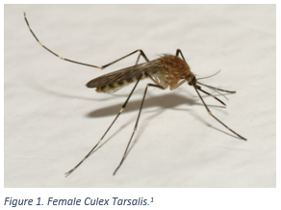
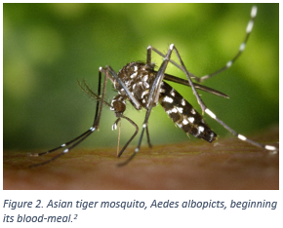
Why Study Mosquitoes?
Mosquitoes are key members of both aquatic and terrestrial food chains
Mosquitoes are known vectors for human diseases (Rochlin et al. 2013)
A useful taxon for studying the impacts of climate change (Hoekman et al. 2016)

Slide 3
Goals and Project Components
Goal of Project: Create a data tutorial that allows researchers to engage with NEON data
Two avenues of exploration:
Vignette 1: Species richness over a latitudinal gradient
Latitudinal diversity gradients (LDGs) have been observed in other species but little work has been done on mosquitoes (Jetz and Rahbek 2001, Mora et al. 2005)
Vignette 2: Julian date of observation for Culex tarsalis
Culex tarsalis is a known carrier of diseases such as West Nile Virus
Possibility of changes in date of observation due to biotic factors

Slide 4
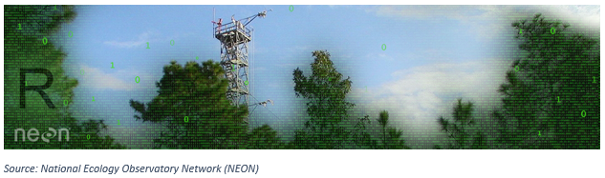
Data Cleaning Methods
Initial Project Challenges:
Obtaining location information from NEON
Combining data frames
Filtering data based on certain criteria
Methods for addressing challenges:
lapply
merge
filter

Slide 5
The lapply function
The lapply() function in R applies a function of your choosing to a list or vector and returns a list of results.

Slide 6
Merging Data Frames
The merge function allows the user to join together two data frames horizontally by key variables
The merge function will only include rows with matching information in the key variable column in the resulting data frame
Code Example: merge(x = Data Frame 1, y = Data Frame 2, by = “Var B”)
Data Frame 1
Data Frame 2
Result
Row # | Var A | Var B
1 | NA | 77
2 | Blue | 121
Row # | Var B | Var C
1 | 49 | Red
2 | 77 | Red
merge()
Row # | Var B | Var C | Var A
1 | 77 | Red | NA

Slide 7
Using the filter function
The filter function is used to select only certain rows of a data frame based on user specified criteria.
Code Example: dplyr::filter(Starting Data Frame$scientificName==“Culex tarsalis”)
Starting Data Frame
Result
scientificName | Count
Aedes albopictus | 82
Culex tarsalis | 103
Aedes aegypti | 8
Culex tarsalis | 64
dplyr::filter()
scientificName | Count
Culex tarsalis | 103
Culex tarsalis | 64

Slide 8
Omitted and Missing Data
Omitted Data:
Years 2012, 2013, and 2015 have been omitted
Any observations with missing plot identifications have been omitted
Observations where species or subspecies was indeterminate were omitted
Missing Data:
4530 observations in our data do not have location information
A large number of observations are missing from temperature and precipitation data
Notes:
4530/ 41080

Slide 9
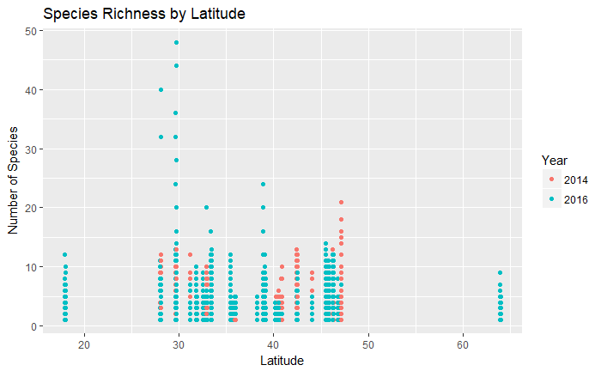
Vignette 1: Species Richness

Slide 10
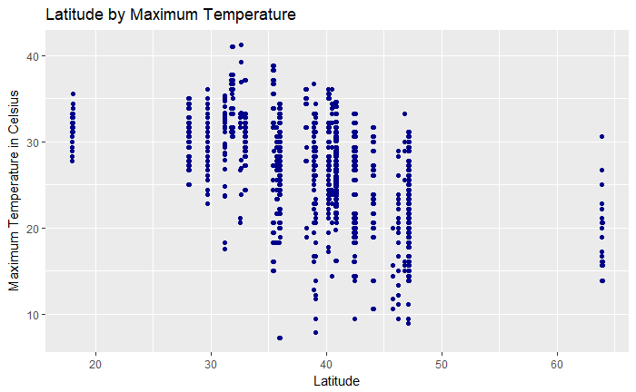
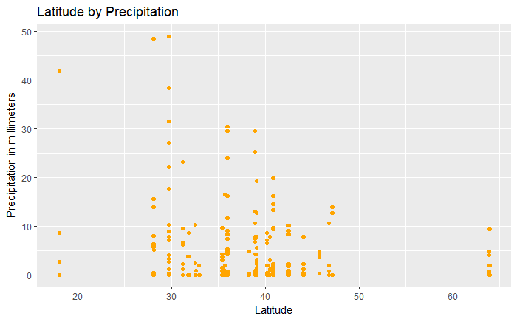
Vignette 1: Species Richness
Latitude is a proxy for environmental factors such as temperature and precipitation

Slide 11
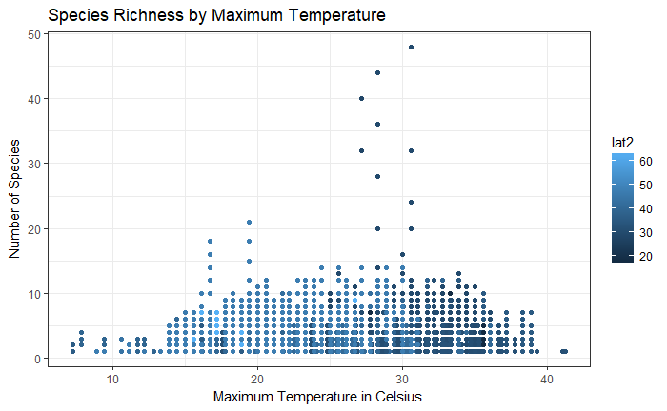
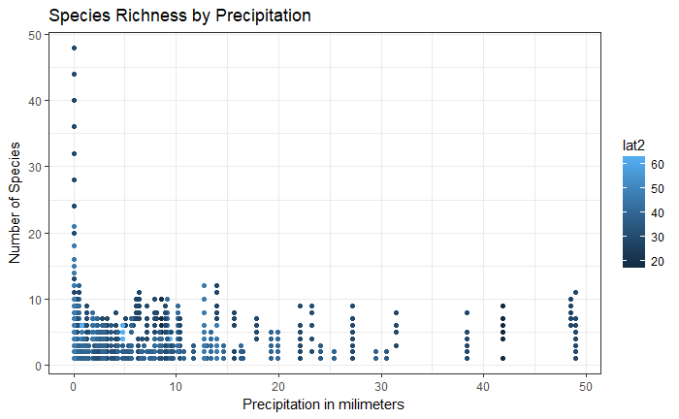
Vignette 1: Species Richness

Slide 12
Vignette 1: Species Richness

Slide 13
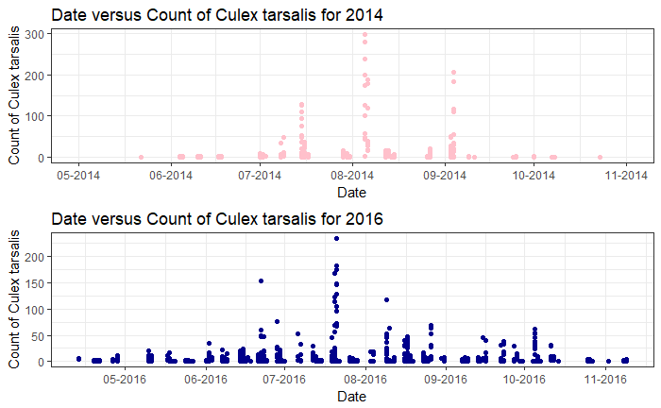
Vignette 2: Culex tarsalis

Slide 14
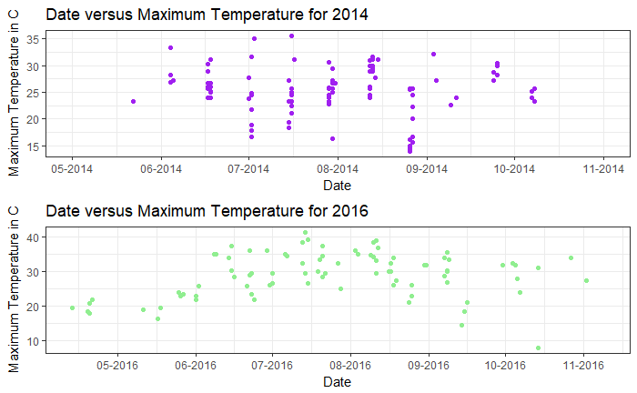
Vignette 2: Culex tarsalis

Slide 15
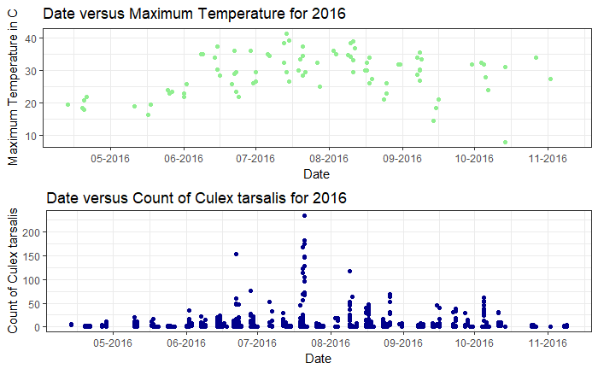
Vignette 2: Culex tarsalis

Slide 16
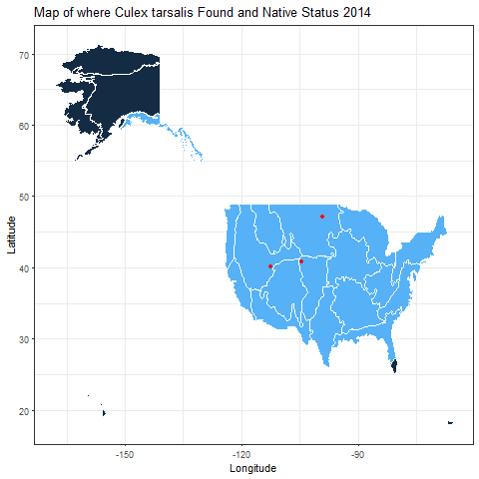
Vignette 2: Culex tarsalis
Native Status:
Native
Absent

Slide 17
Bibliography
Hoekman, D., Y. P. Springer, C. M. Barker, R. Barrera, M. S. Blackmore, W. E. Bradshaw, D. H. Foley, H. S. Ginsberg, M. H. Hayden, C. M. Holzapfel, S. A. Juliano, L. D. Kramer, S. L. LaDeau, T. P. Livdahl, C. G. Moore, R. S. Nasci, W. K. Reisen, and H. M. Savage. 2016. Design for mosquito abundance, diversity, and phenology sampling within the National Ecological Observatory Network. Ecosphere 7:1–13.
Jetz, W., and C. Rahbek. 2001. Geometric constraints explain much of the species richness pattern in African birds. Proceedings of the National Academy of Sciences 98:5661–5666.
Mora, C., D. R. Robertson, Camilo Mora, and D. Ross Robertson. 2005. Causes of Latitudinal Gradients in Species Richness : a Test With Fishes of the Tropical Eastern Pacific. America 86:1771–1782.
Rochlin, I., D. V. Ninivaggi, M. L. Hutchinson, and A. Farajollahi. 2013. Climate Change and Range Expansion of the Asian Tiger Mosquito (Aedes albopictus) in Northeastern USA: Implications for Public Health Practitioners. PLoS ONE 8:1–9.

Slide 18
Image Sources
Bryant, P. J. 2007. Western Encephalitis Mosquito. Natural History of Orange County, California and Nearby Places. University of California, Irvine.
Gathany, J. 2002. Asian tiger mosquito, Aedes albopicts, beginning its blood-meal. Center for Disease Control and Prevention's Public Health Image Library. Center for Disease Control and Prevention.

Slide 19
Acknowledgements
Special thanks to Katie Levan and Cody Flagg for providing mentorship, resources, and coding expertise.

